Slide 1
UE19CS204 - Web Technologies
Mini - Project
Chat App
Section - A
Akanksha Akkihal - PES1UG19CS039
Aman Kumar M - PES1UG19CS050
Github: Click here

Slide 2
—HASHTAG.US
Be connected to the world. Expand your network, your network is your net worth

Slide 3
ABSTRACT
We have developed a text and video chat application using MERN stack.
Our aim is to connect the people and help them expand their network.
Our App has a smooth user experience and is easy to use. It has a responsive web design and has two features i.e. Text Chat and Video chat.
HASHTAG.US

Slide 4





TECH stack
01
05
React
PeerJS
02
06
Express
Webpack
03
07
Socket.IO
React-Bootstrap
04
08
MongoDB
NodeJS

Slide 5
TEAM
AKANKSHA AKKIHAL
AMAN KUMAR M
Landing Page.
Video Chat component.
Text Chat component.
Integration of frontend and backend.
Bundling ES6.

Slide 6
TIMELINE
WEEK 5-6
FINAL
VERSION
LEARNING PHASE
WEEK 3-4
WEEK 7-8
Week 1-2
Structuring the components , web design and getting used to GItHub.
Landing Page , text and video chat components done.
Text and Video chat components started.
Integration of components, routing and final styling.

Slide 7
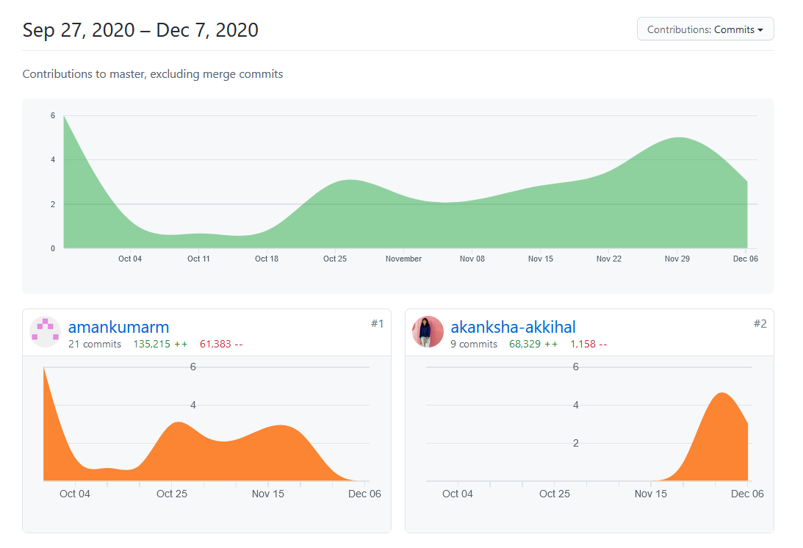
Github Insight

Slide 8
</Presentation>

